Slide 1

Know Before You Go:
GAC 2026

Slide 2

Illinois Delegation Pre-GAC Briefing
Wednesday, February 25, 2026
2:00 P.M.

Slide 3
Today’s Agenda
Introductory Remarks – Libby Calderone
Conference Logistics – Abby Walsh
Credit Union Legislative & Regulatory Priorities – Patrick Smith and Brad Thaler
NCUA/CFPB Issues – Patrick Smith
State Interchange Update – Ashley Sharp
Questions?

Slide 4

2013 – 69
2014 - 63
2015 - 69
2016 - 60
2017 - 87
2018 - 78
2019 - 90
2020 - 88
2021 - Virtual
2022 - 67
2023 - 81
2024 - 99
2025 - 103
Welcome!
109 Attendees from Illinois
15 First-Time Attendees
Crasher: Sabrina Sibert, SOCU

Slide 5








Thank You to Our Sponsors!
HOSPITALITY SPONSOR
DEBRIEF SPONSOR
LUNCH SPONSOR
DINNER SPONSOR
TAG YOUR PLANNING

Slide 6
Conference Logistics
FROM AIRPORT
SHUTTLE BUSES
WEDNESDAY LUNCH
Shuttle buses between hotels and Convention center start Sunday.
Pick up will be at the Grand Hyatt 10th Street side entrance.
Hours will be posted.
Take a taxi or rideshare transportation, i.e., Uber to the Wednesday lunch on Capitol Hill.
Taxi/Uber/Lyft fee $20-$30

Slide 7
Conference Logistics
REMEMBER: TIME CHANGE
Make sure your mobile calendar and watch are changed to Eastern Standard Time!

Slide 8
Conference Logistics
OFF SITE: MARRIOTT MARQUIS & GRAND HYATT HOTELS
SATURDAY, FEBRUARY 28
SUNDAY, MARCH 1
8:00 A.M. – 6:00 P.M.
8:00 A.M. – 5:00 P.M.
WASHINGTON CONVENTION CENTER
SUNDAY, MARCH 1
MONDAY, MARCH 2
TUESDAY, MARCH 3
WEDNESDAY, MARCH 4
11:30 A.M. – 6:00 P.M.
7:00 A.M. – 5:15 P.M.
7:30 A.M. – 5:00 P.M.
7:45 A.M. – 11:30 P.M.

Slide 9
Sunday, March 1, 2026
2:00 P.M. – 6:00 P.M. | Illinois Delegation Hospitality Suite
Grand Hyatt Hotel, Tiber Creek Room
4:00 P.M. – 5:00 P.M. | General Session
Washington Convention Center
5:00 P.M. – 7:00 P.M. | Exhibit Hall Open
Washington Convention Center
6:00 P.M. – 9:00 pm | Private Illinois Delegation Reception
Sponsored by Envisant and TruStage
Mastro’s Steakhouse
Cocktails 6-7 p.m.
Dinner 7 p.m.

Slide 10
Monday, March 2, 2026
8:00 A.M. – 9:15 A.M. |
9:30 A.M. – 11:40 A.M. |
11:40 A.M. – 1:00 P.M. |
1:15 P.M. – 3:00 P.M. |
3:15 P.M. – 4:15 P.M. |
4:00 P.M. – 6:30 P.M. |
4:15 P.M. – 5:30 P.M. |
6:30 P.M. |
Exhibit Hall Open/Breakfast
Washington Convention Center
General Session 1
Exhibit Hall Open/Lunch
General Session, ACU Annual Meeting, & Advocacy Update
Breakout Sessions
Illinois Delegation Hospitality Suite
Grand Hyatt Hotel
Exhibit Hall Open
Herb Wegner Memorial Award Gala
(Separate Ticketed Event)
Marriott Marquis

Slide 11
Tuesday, March 3, 2026
8:00 A.M. – 9:15 A.M. |
9:30 A.M. – 11:40 A.M. |
11:40 A.M. – 1:00 P.M. |
1:00 P.M. – 2:00 P.M. |
2:15 P.M. – 3:00 P.M. |
3:15 P.M. – 4:00 P.M. |
4:00 P.M. – 5:15 P.M. |
4:00 P.M. – 6:30 P.M. |
Exhibit Hall Open/Breakfast
General Session
Exhibit Hall Open/Lunch
Breakout Sessions
Breakout Sessions
Breakout Sessions
Exhibit Hall Open
Illinois Delegation Hospitality Suite
Grand Hyatt Hotel
Congratulations to Joe Kregul and Tim O’Donnell – Credit Union House Hall of Fame Inductees!

Slide 12
Wednesday, March 4, 2026
8:00 A.M. – 9:00 A.M. |
9:00 A.M. – 11:15 A.M. |
11:30 A.M. |
1:30 P.M. – 5:00 P.M. |
3:00 P.M. – 6:30 P.M. |
7:00 P.M. – 10:00 P.M. |
Breakfast
Washington Convention Center
Closing General Session
Pre-Congressional Office Visit, Legislative
Briefing, & Luncheon
Special Guest: Senator Tammy Duckworth
Library of Congress
101 Independence Avenue SE, Washington D.C. 20540
Capitol Hill Visits
Illinois Delegation Hospitality Suite; Congressional Visit Debriefing
Grant Hyatt Hotel
Closing GAC Event
Marriott Marquis

Slide 13
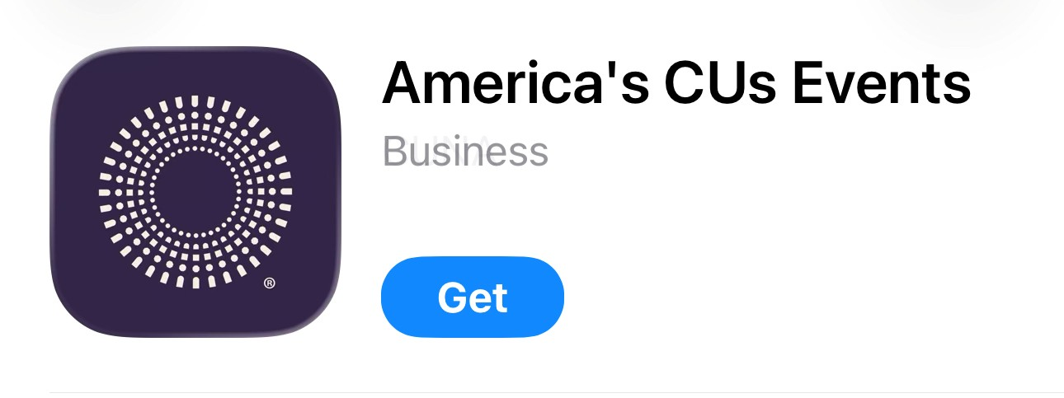
Conference Highlights
New Attendee Orientation
Sunday 2:30-3:15 pm at Convention Center
Download GAC App (search America's CUs Events)
Use code for access: #GAC2026
Limited printed material will be provided
Materials will be available on
ICUL website
https://www.icul.com/advocacy/cupac/gac-attendee-page/

Slide 14
THANK YOU, HOSPITALITY SPONSORS!
Conference Highlights
Hospitality Room
Grand Hyatt Hotel – Tiber Creek Room
Constitution Level (3B)
Room Times
Sunday 2:00-6:00pm
Monday 4:00-6:30pm
Tuesday 4:00-6:30pm
Wednesday 3:00-6:30pm

Slide 15
ACU PAC Sweepstakes
Sweepstakes officially opens at 12 a.m. EST Sunday, March 1
and closes at 11 a.m. EST on Thursday, March 5.
https://pac.americascreditunions.org/fundraise/formid/gacsweepstakes/
Your credit union must have a current permission agreement on file to participate.
Contributions to America’s Credit Unions PAC are not tax deductible.
All contributions are voluntary and will be used for political purposes. You have the right to refuse to contribute without reprisal. Guidelines contained herein are merely suggestions. You may contribute more or less than the guidelines suggest, and America’s Credit Unions will not favor nor disadvantage you by reason of the amount of your contribution or a decision not to contribute.
You must be 18 years of age or older as of the date of entry in order to enter. Offer void where prohibited. Contest is void in Alabama, Arkansas, Florida, Georgia, Hawaii, Minnesota, Oklahoma, Texas, and Wisconsin. Click here to view official rules.

Slide 16
Support
Preserving CU Tax Exempt Status
Support
Credit Union Board Act Modernization – Board Meetings (S. 522)
Oppose
Interchange expansion to credit cards (S. 3623 | H.R. 7035) Credit Card Competition Act)
Support
National Standard for Data Security & Privacy
Support
CDFI Fund Transparency Act (S. 2704)
Support
Veterans Members Business Loan Act - loans to veterans exempt from MBL cap (S. 110 | H.R. 507)
Support
Expand Access to Lending Options Act - push loan maturities caps from 15 to 20 years (H.R. 4167/S. 3616)
America’s Credit Unions
2026 Legislative Priorities

Slide 17

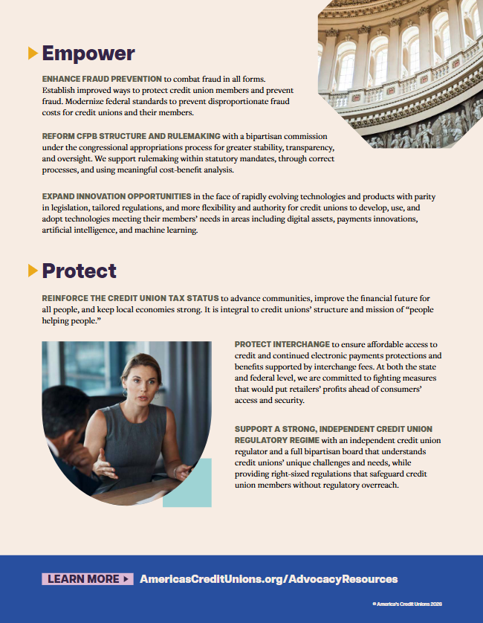

Slide 18
You will be scheduled in 1-2 Congressional visits. Please review entire list (provided via email and at lunch briefing).
Each Team will have a Captain who will have the leave behind lobby packet and kick off the meeting.
If unable to make assigned hill visit, notify a team member or Abby, so they don’t wait for you.
Allow time for security lines
Use taxi or Uber/Lyft to get to and from Capitol Hill and back to WCC or hotel.
Hike The Hill Day!

Slide 19
Use underground tunnels to move between buildings: Cannon – Longworth – Rayburn
Meet in hallway outside office 5-10 minutes before meeting
Stick to credit union topics
Don’t talk about fundraisers or PAC activity in Congressional office buildings
Hill Visit Tips

Slide 20
Share how your members are impacted
Payments & data security
  How has your credit union been impacted by data breaches? Cost estimates?
Impact of potential credit card interchange regulations to your credit union
Examples of how your credit union serves the community & provides financial wellness
Take photos of your meeting and share with ICUL for social.
Send thank you
  pick up business cards in congressional offices to obtain email addresses
Hill Visit Tips

Slide 21
Items to Bring
  Business cards
  Annual report or information about your credit union
  Examples of the cost of data breach/regulatory burden
  Examples of your credit union serving the community
Hill visit debrief in hospitality suite upon completion
Sponsored by ASI/ESI
Hike The Hill Day!

Slide 22
Abby’s Cell Phone
630-352-9562

Slide 23
State Interchange Update

Slide 24
Questions?
Have a safe trip to DC!

